Slide 1
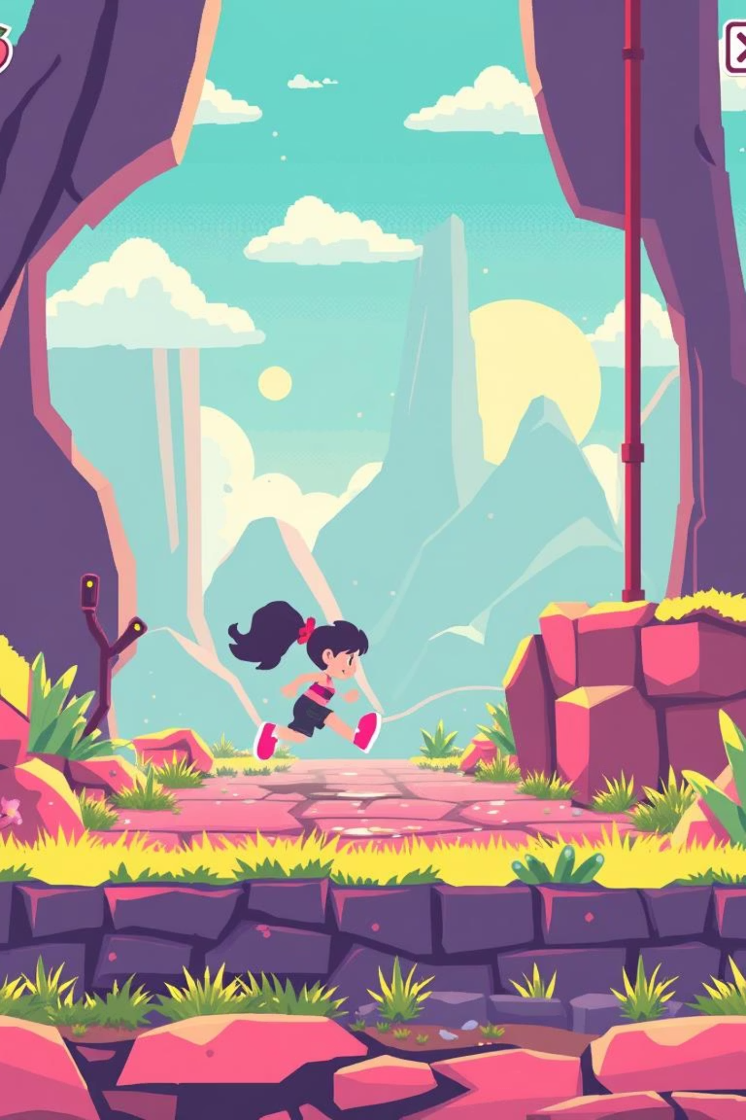

Byte Runner: Dash into Adventure!
Byte Runner is a fast-paced 2D endless runner game developed using HTML5, CSS3, and Vanilla JavaScript. It is designed for instant fun and high replayability, offering a thrilling experience for players of all ages.
by Mohamed Danish

Slide 2
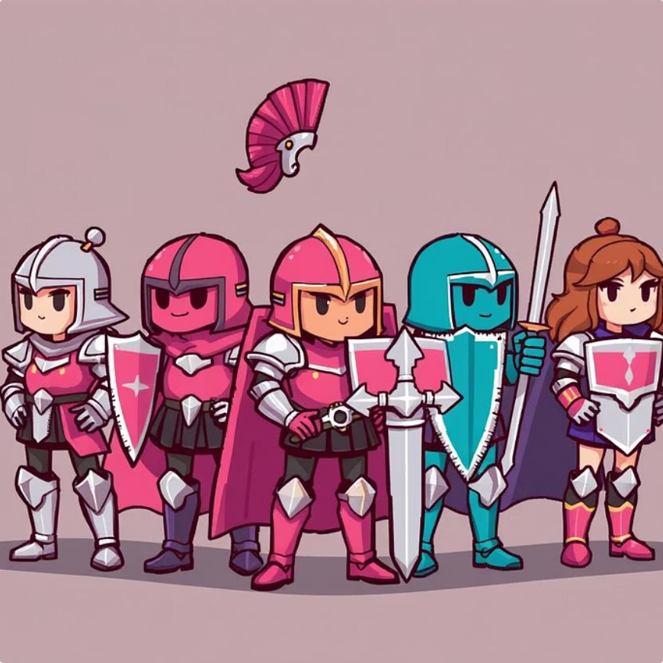
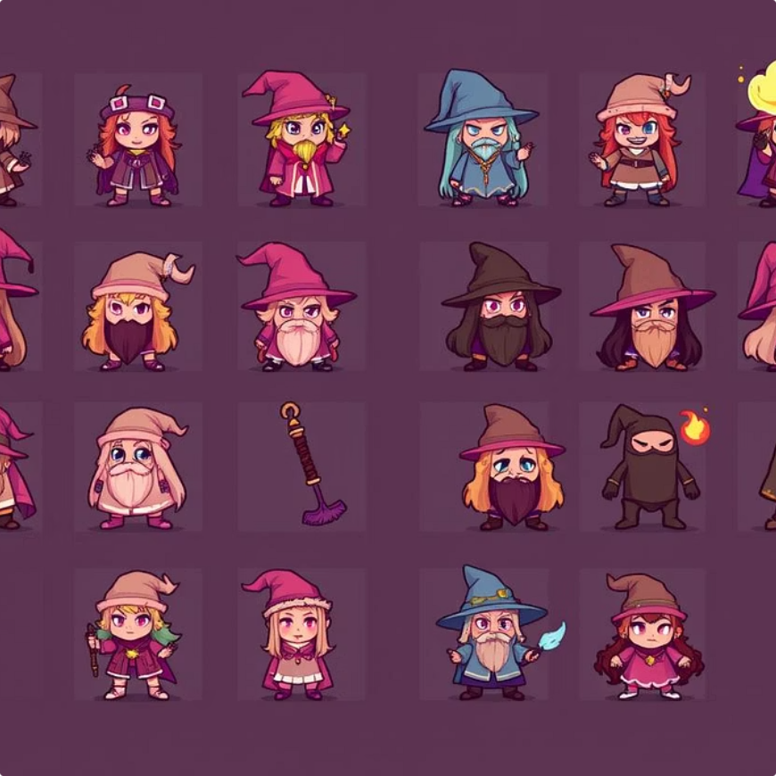
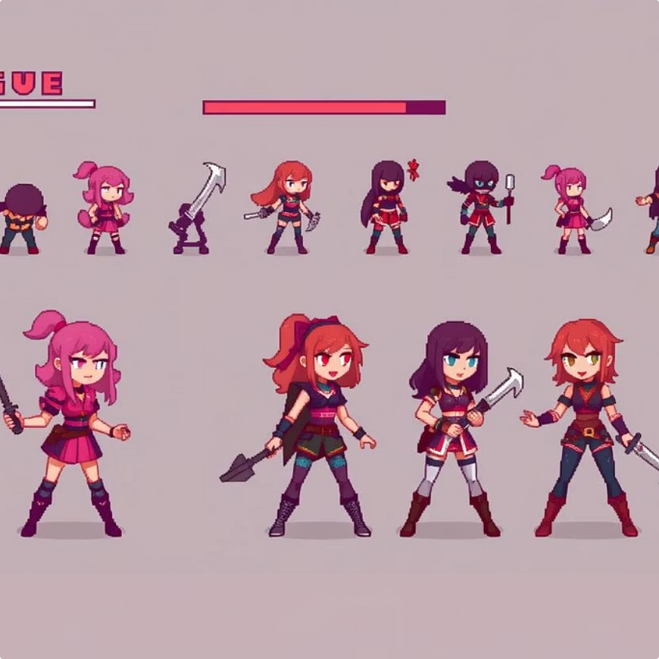
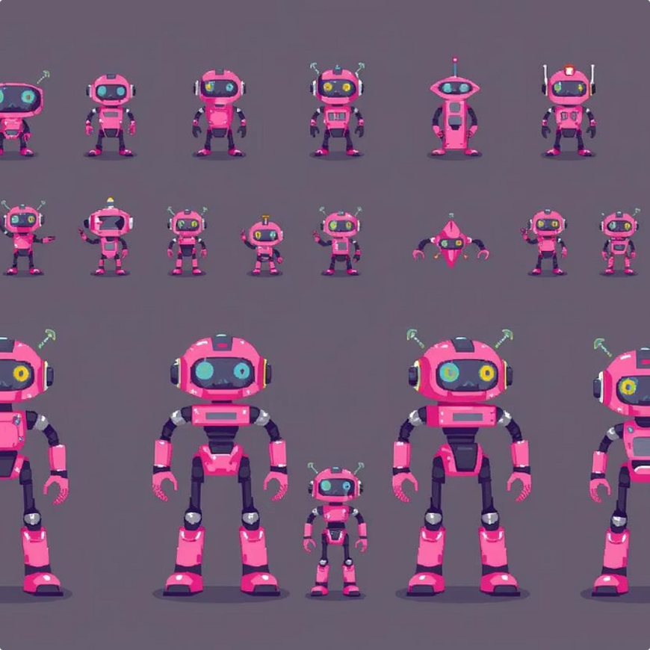

Engage on Entry: The Character Select Screen
Knight
Wizard
Rogue
Robot
Brave and steadfast, ready for any challenge.
Mystical and wise, conjuring paths to victory.
Nimble and swift, dodging danger with ease.
Mechanical and precise, engineered for speed.
Ninja
Silent and deadly, mastering the art of evasion.
The intuitive welcome page features a "Start Game" button and presents 5 unique pixel-art characters. Dynamic previews and brief descriptions help players choose their avatar, which impacts the visual style but not gameplay statistics.

Slide 3
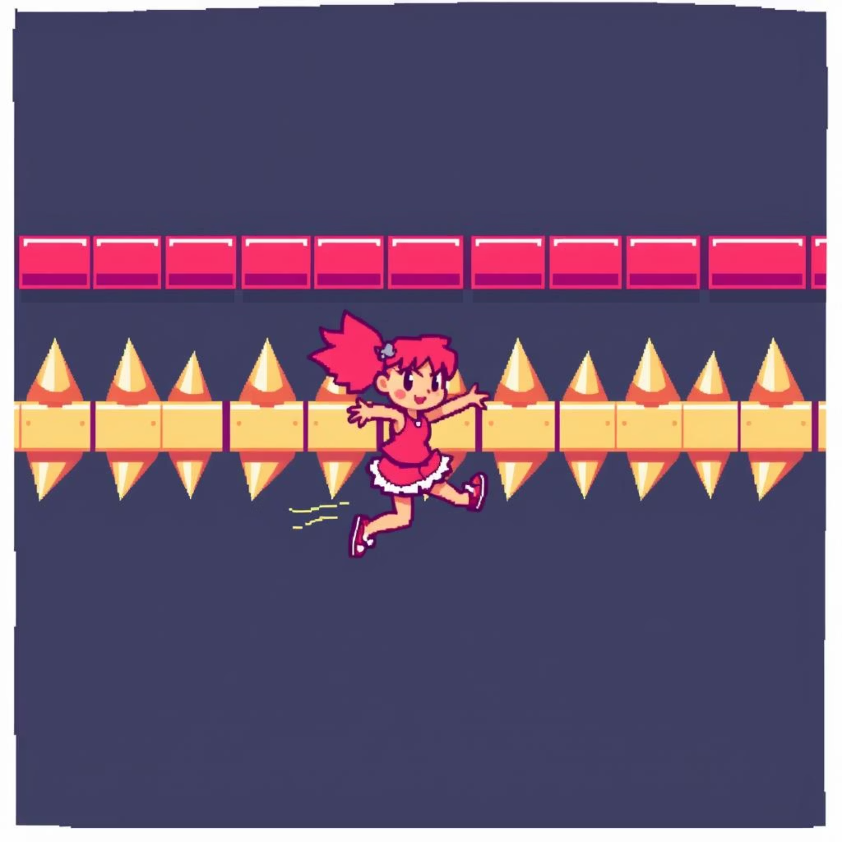
The Core Loop: Run, Dodge, Collect!
In Byte Runner, your chosen character automatically runs through procedurally generated levels, ensuring a fresh experience every time. The primary objective is to avoid three distinct obstacle types: menacing spiked barriers, unpredictable falling rocks, and treacherous bottomless pits.
Players also collect shiny coins to gain points. Standard coins are worth 10 points, while rare gems offer a lucrative 50 points. The game progressively accelerates every 60 seconds, increasing difficulty by a challenging 15% to keep players on their toes.

Slide 4

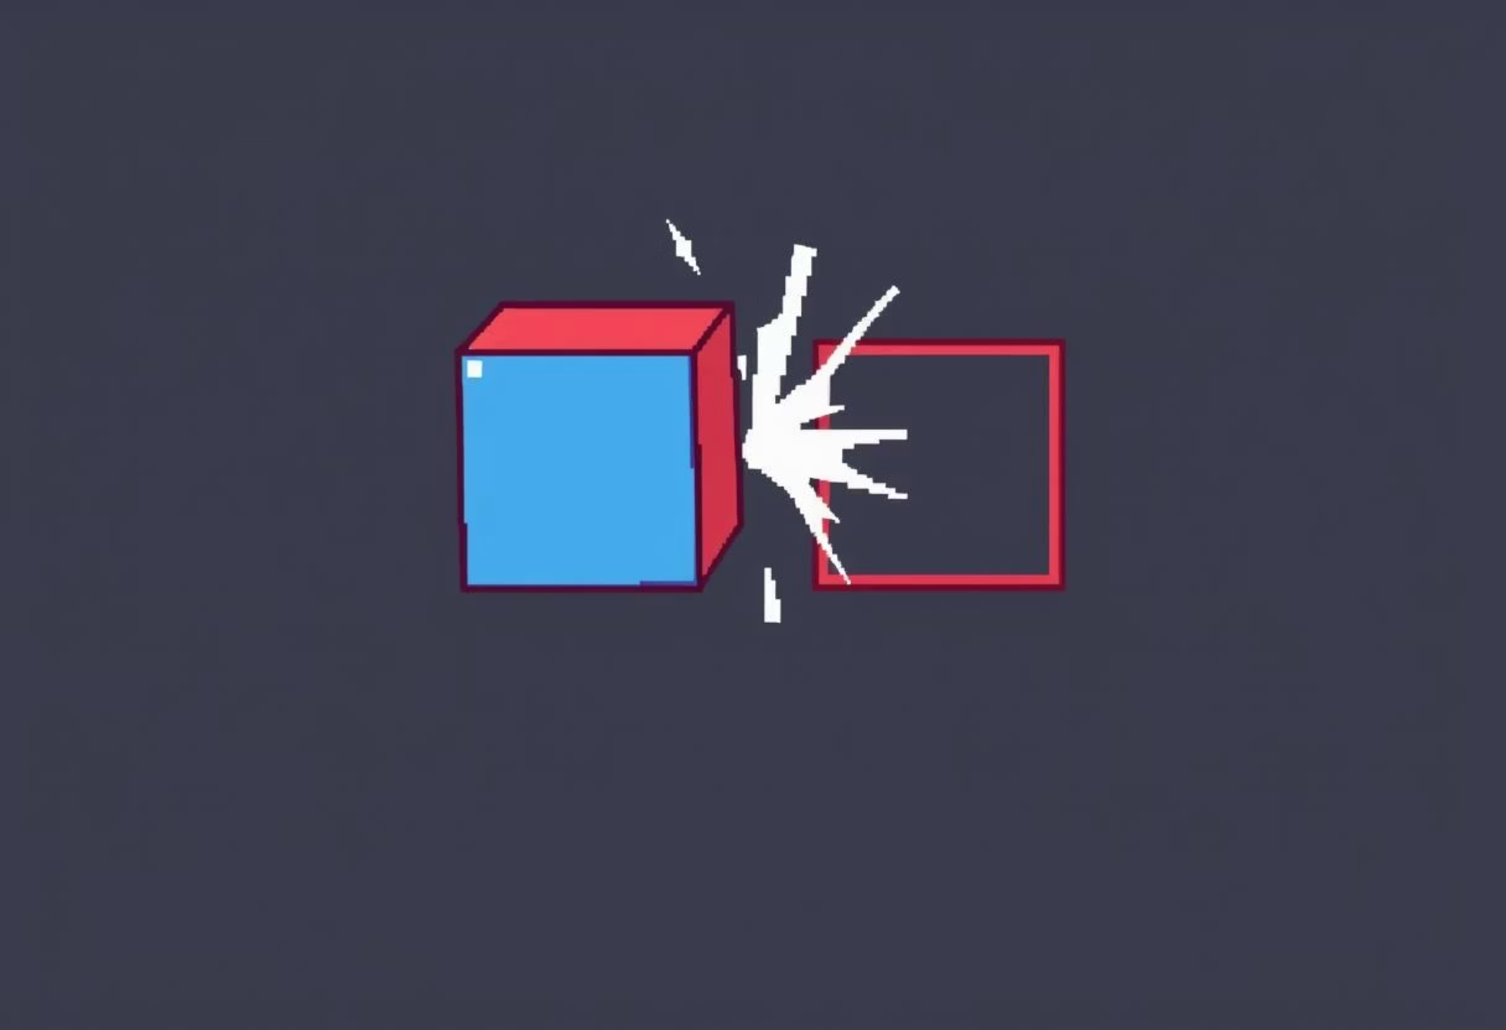



Dynamic Obstacles & Scoring Mechanics
1
Collision Detection
A precise bounding box algorithm ensures accurate collision detection with obstacles, making every dodge count.
2
Scoring System
Your score is calculated by the distance covered (1 point per 10 pixels) combined with the coins collected throughout your run.
3
Game Over Conditions
The game concludes with a "Game Over" state triggered by the first obstacle collision or a fall into a bottomless pit.
4
Responsive Controls
Enjoy seamless play with responsive input: 'Spacebar' or 'Up Arrow' for desktop users, and a single touch for mobile devices.

Slide 5

Chasing Glory: The High Score System
1
5
10000+
♾️
Real-Time Display
Persistent Storage
Top Score Board
Competitive Spirit
Your current score is prominently displayed in the top-right corner during gameplay, keeping you informed of your progress.
The high score is securely persisted locally using the HTML5 Local Storage API, so your achievements are always saved.
The top 5 high scores are proudly showcased on the welcome screen, instantly refreshing when a new record is set.
This system actively encourages competitive play and fosters continuous self-improvement among players, striving for that elusive new high score.

Slide 6
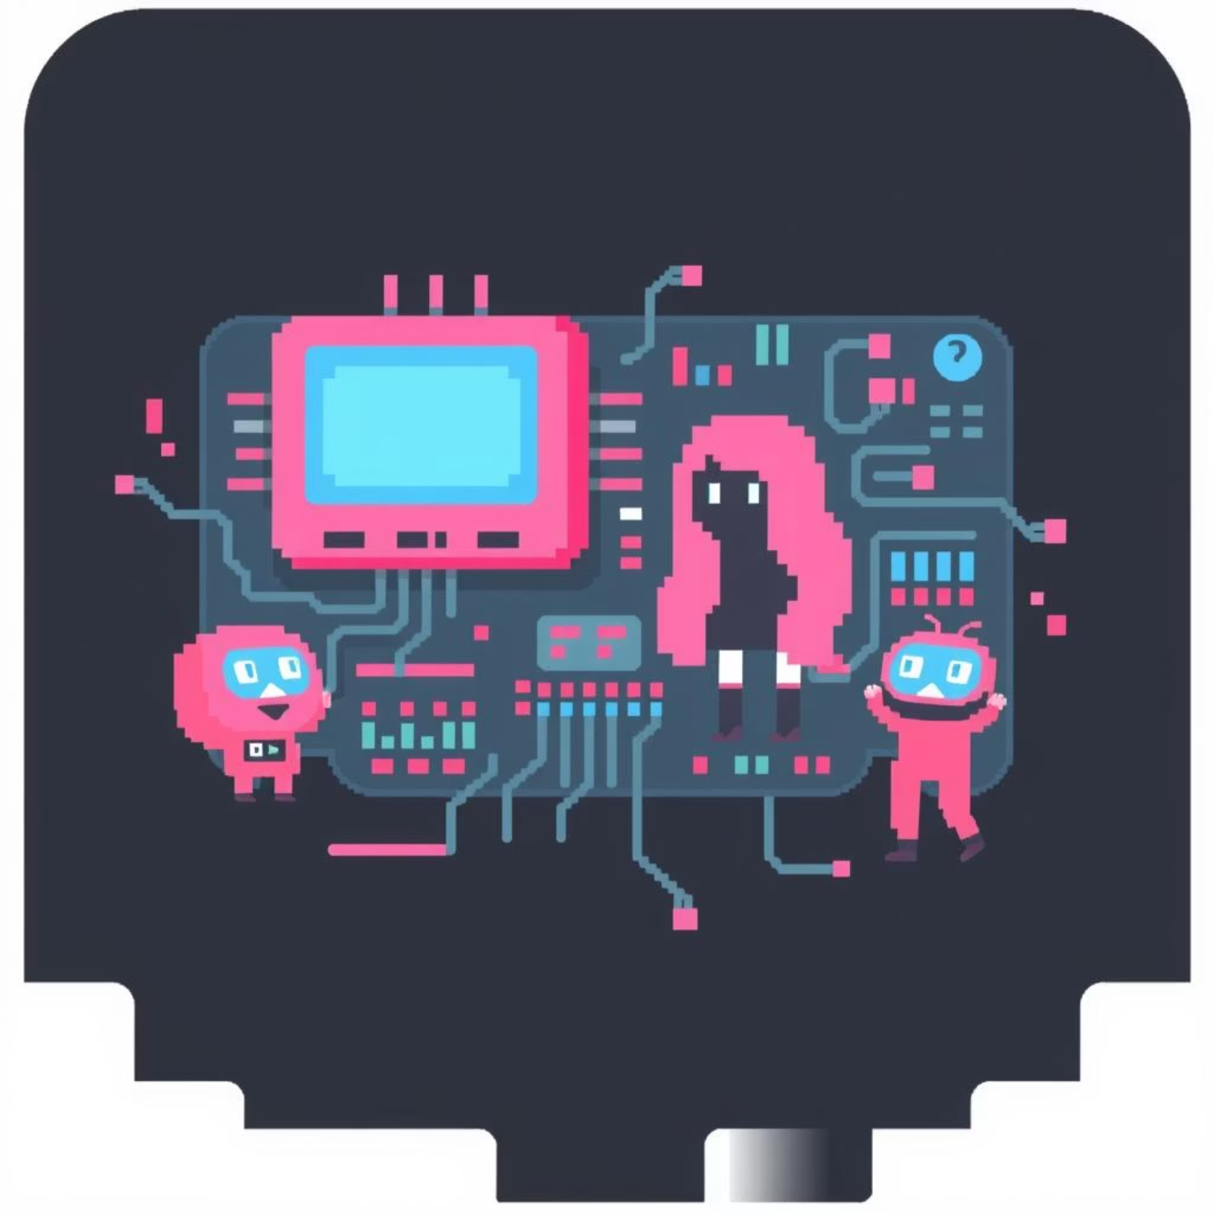
Under the Hood: Lean HTML, CSS, JavaScript
HTML5 Canvas API
The game is rendered using the HTML5 Canvas API, ensuring silky-smooth 60 FPS animation for a fluid gameplay experience.
CSS3 for UI
CSS3 is extensively used for responsive layout and engaging UI transitions, such as the dynamic character selection animations.
Vanilla JavaScript
Vanilla JavaScript powers all core game logic, physics, asset loading, and input handling, keeping the codebase clean and efficient.
Optimised Performance
Byte Runner is optimised for low resource usage and rapid loading times, with a total asset size under 2MB for quick access.

Slide 7





Why Byte Runner Captivates Players
Addictive Loop
The "just one more run" gameplay loop is incredibly addictive, consistently driving player engagement and extended sessions.
Simple Controls
With intuitive one-button controls, Byte Runner is accessible to players of all ages and skill levels, making it easy to pick up and play.
Appealing Aesthetics
The visually appealing pixel-art aesthetic combined with vibrant sound effects creates a deeply immersive and enjoyable experience.
Endless Replayability
Procedural generation, variable difficulty, and the high score chase provide endless replayability, ensuring long-term fun.

Slide 8

The Road Ahead: Expanding Byte Runner
We have exciting plans for Byte Runner's future, focusing on continuous improvement and new content to keep the game fresh and engaging for our community.
Future Updates
Introducing 2 new environments and 3 exciting power-ups, such as temporary invincibility and coin magnets, to enhance gameplay.
Online Features
Exploring potential for online leaderboards and social sharing features, leveraging third-party APIs to foster a competitive community.
Mobile Deployment
Investigating mobile app store deployment options via frameworks like Cordova or Electron, bringing Byte Runner to a wider audience.
Community Driven
Committed to community feedback-driven development for continuous improvements and the creation of new, player-requested content.

